Slide 1
How to write the introduction
for a research paper
in three easy steps

Slide 2
Introduction
This talk will show how to write an introduction to a research paper in 3 easy steps
STEP1: make a plan
STEP2: write!
STEP3: edit edit edit

Slide 3
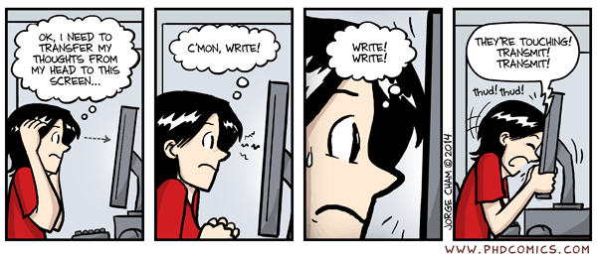
Step 1: make a plan

Slide 4
Step 1: make a plan
Write down in bullets:
your contribution
what problem is it solving?
what is the evaluation that proves it?

Slide 5
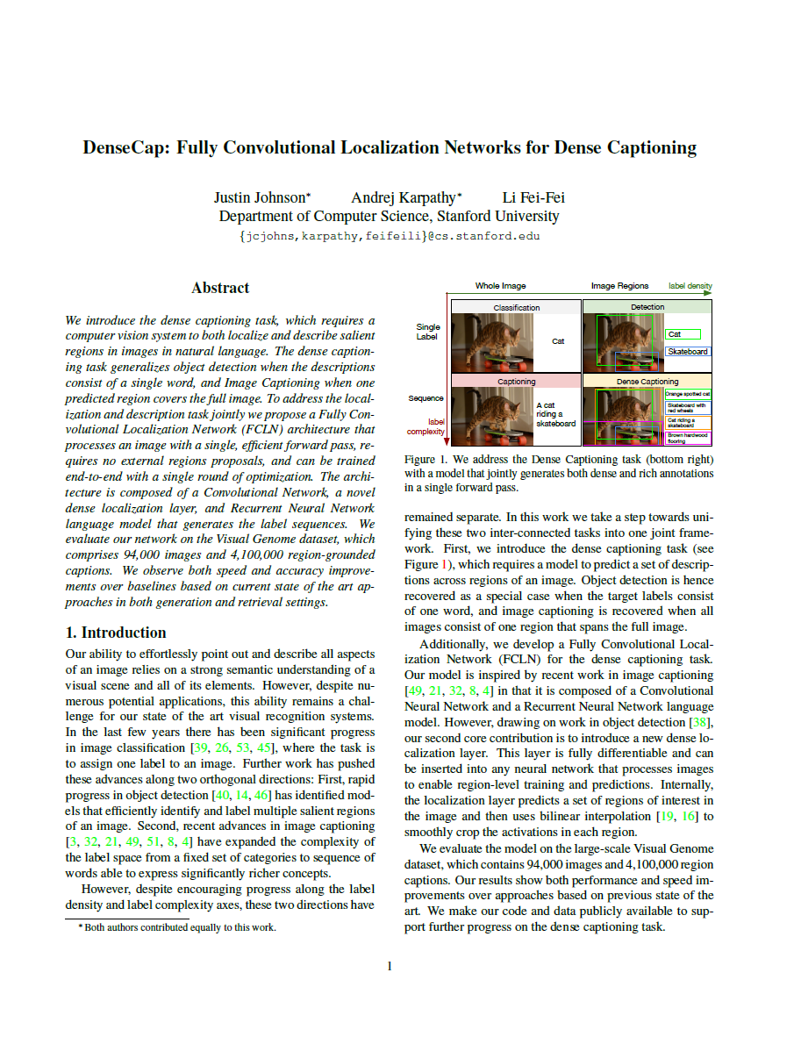
Step 1: make a plan
example
Contribution:
Propose dense caption task
Design new end-to-end model
Problem:
Current methods fail...
No one has tried this...
Evaluation:
Compare to baseline X on dataset Y
Tease a promising result
https://cs.stanford.edu/people/karpathy/densecap.pdf

Slide 6


One idea is better than many!
Bad: too many things at once
Good: reader has an “aha!” moment

Slide 7
Step 1: expanD plan
Re-write bullets into following structure*:
task
state-of-the-art
flaw in state-of-the-art
your idea/solution
proof it works
*this is usually easier to do for beginners than starting with this structure

Slide 8
Step 1: expanD plan
Example
title
figure 1
abstract
idea
task
SotA
flaw
proof

Slide 9
Step 1: expanD plan
TASK
What can it do?
State the task your model solves
Usually only need one sentence
Can mention applications
Why do we need this?
Avoid reader frustration!
(reads to page 7): oh, they’re doing detection, not classification!? $#@#$%!!
task

Slide 10
Step 1: expanD plan
State-of-the-art
What is the best we can do now?
Briefly cite recent work (direct competition)
Get the reader excited about area
“Significant progress”, “exciting results”
Common mistakes:
Writing more than one paragraph (that is what related work is for!)
Diminishing prior work. You’re standing on the shoulders of giants. Praise is better.
SotA

Slide 11
Step 1: expanD plan
FLAW
What can’t we do yet?
What is the critical flaw in SotA? (you’ll be providing a solution to this later...)
Why should the reader care? No, really?
Why can’t X, Y or Z be used to solve this?
Engage the reader
Use an example: text, or visual (see Figure 1)
At the end, the reader should be thinking, wow, this is really a important problem! I really wish someone would try to solve it!!
flaw

Slide 12
Step 1: expanD plan
idea
What you propose to fix the flaw
The “hero”
Comes to the rescue
Keep it brief
Give the main intuition
“We solve this by adding a new DNN layer”
Leave the gory details to the method section!
Tip: if you have 2 ideas, describe each ‘flaw’ before you introduce each idea
idea

Slide 13
Step 1: expanD plan
figure 1
figure 1
“Must have” for a vision paper
Convey the flaw and idea visually
Like an “ad” for your paper
Many people ONLY look at this
If it looks interesting, they will also check the main result table
Caption should be self-explanatory, since they may not read the main text

Slide 14
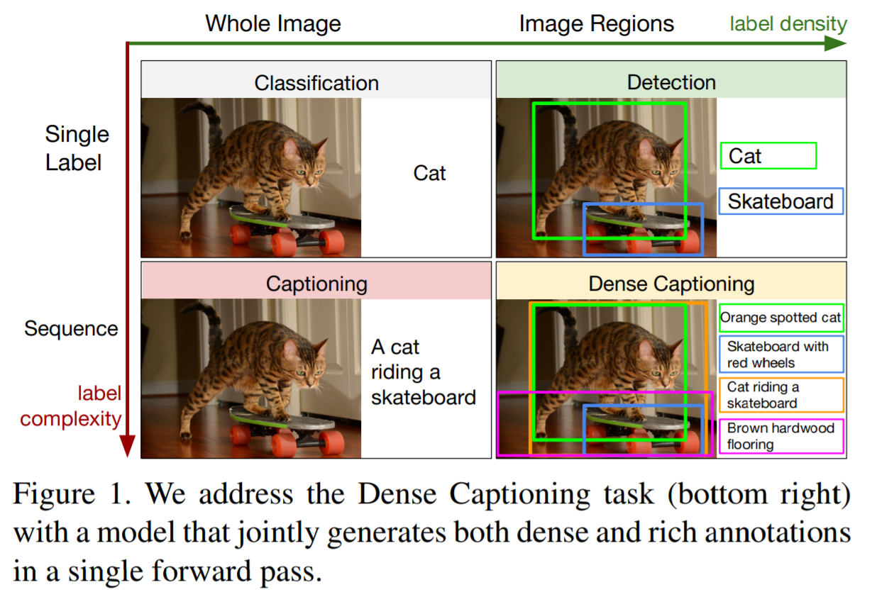
Step 1: expanD plan
figure 1
Better :) shows flaw in prior work
OK figure :| illustrates the task well

Slide 15
Step 1: expanD plan
Proof
Does it work?
Say a bit about evaluation and baselines
Don’t give all away, but tease
E.g. “our method lowers reconstruction error by 20% compared to previous methods”
proof

Slide 16
Step 1: expanD plan
title
title
Specific:
DenseCap: Fully Convolutional Localization Networks for Dense Captioning :)
A Network for Describing Images :(
A Deep Learning Approach Based on Convolutional Neural Network… :(
Memorable:
If using acronym/abbreviation make sure it is easy to spell and pronounce, e.g. FCLN :( vs DenseCap :)
Best if conveys central idea, “dense captioning”
“It’s a bird! It’s a plane! …” and other catchphrases: can be corny, proceed with caution !!!

Slide 17
Step 1: expanD plan
Abstract
Concise:
Summary of task and contributions
Write this last! Copy-paste, rephrase, done!
Audience:
Meant for general audience
“Grandmother” should get the gist
abstract

Slide 18
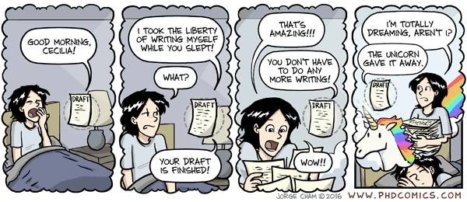
Step 2: write!

Slide 19
Step 2: write!
By now, you should have your introduction outlined in several dozen bullets, so the rest should be much easier
This would be a good time to run it by others
Expand each bullet into sentence/paragraph
Fill in details along the way

Slide 20
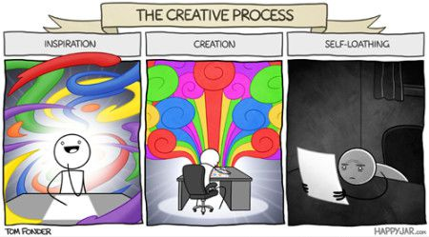
Step 3: edit edit edit

Slide 21
Step 3: edit edit edit
Some lucky people can write near-perfect text in one go
Most of us are not so lucky
I re-write my drafts many times, sometimes dozens
Important to get feedback from your advisor/labmates

Slide 22
That’s it!
Now you just have the rest of the paper to write :)

